Slide 1

Market Index Cycle Analysis
Chengjun Liu

Slide 2

Market has cycles.

Slide 3
Contents
Contexts
Data Analysis
Graphic Solution
Conclusion

Slide 4
Contexts

Slide 5
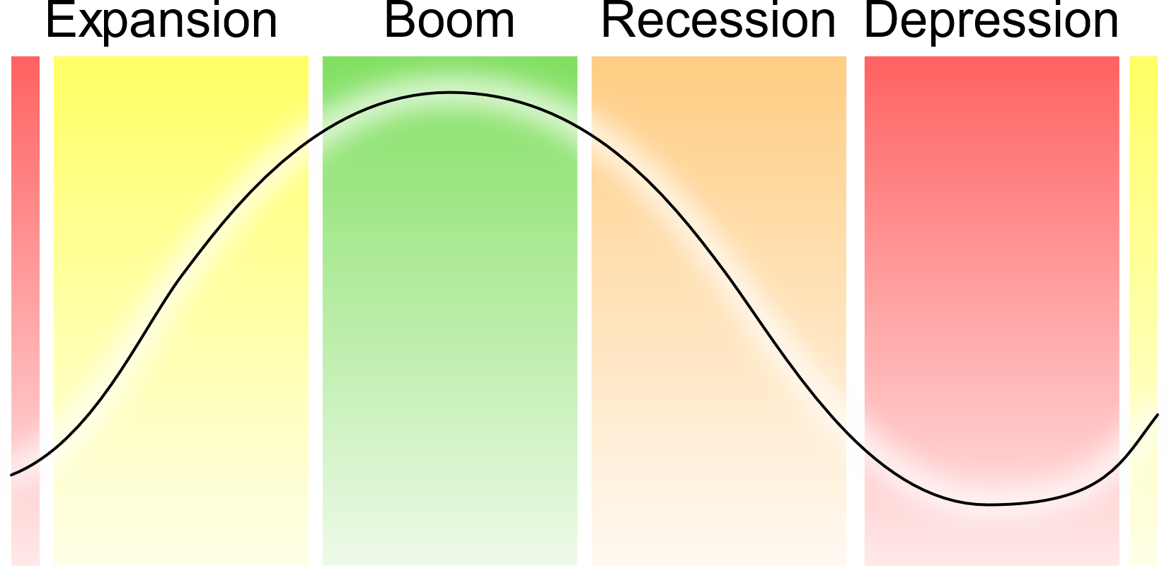
Contexts
Economy goes up and down.

Slide 6
Contexts
Inventory Cycle: 40 months
Fixed Investment: 100 months
Infrastructure Investment: 200 months

Slide 7
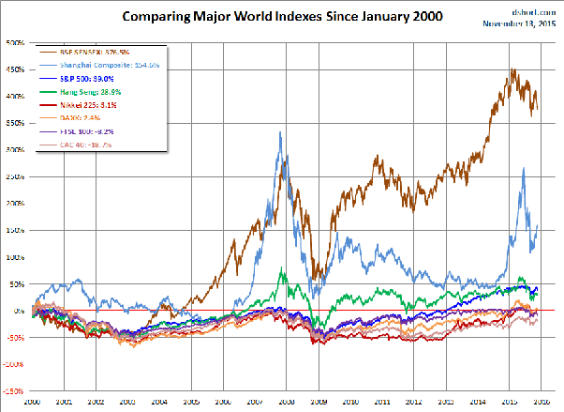
Contexts
We try to detect economic cycles from market indices.

Slide 8
Data Analysis

Slide 9
Data Analysis
We gather the data of six indices.
Region: China
Category: CPI/PPI, M1/M2, Shanghai/Shenzhen Composition
Time:1998~2018

Slide 10
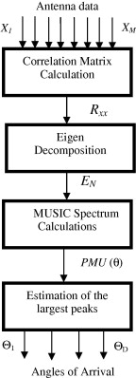
Data Analysis
We use signal algorithm to extract cycles.
$$Common cycles of six indice→Peaks$$

Slide 11
Graphic Solution

Slide 12
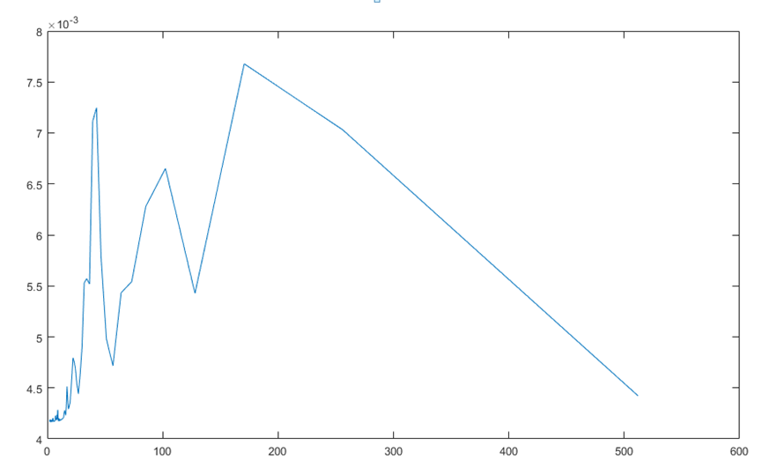
Graphic Solution
We discover the three peaks corresponding to three cycle time.
40M
100M
200M

Slide 13
Conclusion

Slide 14
Cycles exist in indices!
Inventory Cycle: 40 months
Fixed Investment: 100 months
Infrastructure Investment: 200 months

Slide 15

Thank You!

